Slide 1



DB25 Relay Circuit Baord
MEMSDuino
Lafe Spietz
NIST
2024

Slide 2
Abstract
This board uses electromechanical relays to connect the 90 volt line with any of 20 pins on a DB25 (25 pin DSUB) board mount connector which is in the lid of the custom metal box. In the 9 way switch, 16 of these lines are actually used.
MEMSDuino

Slide 3
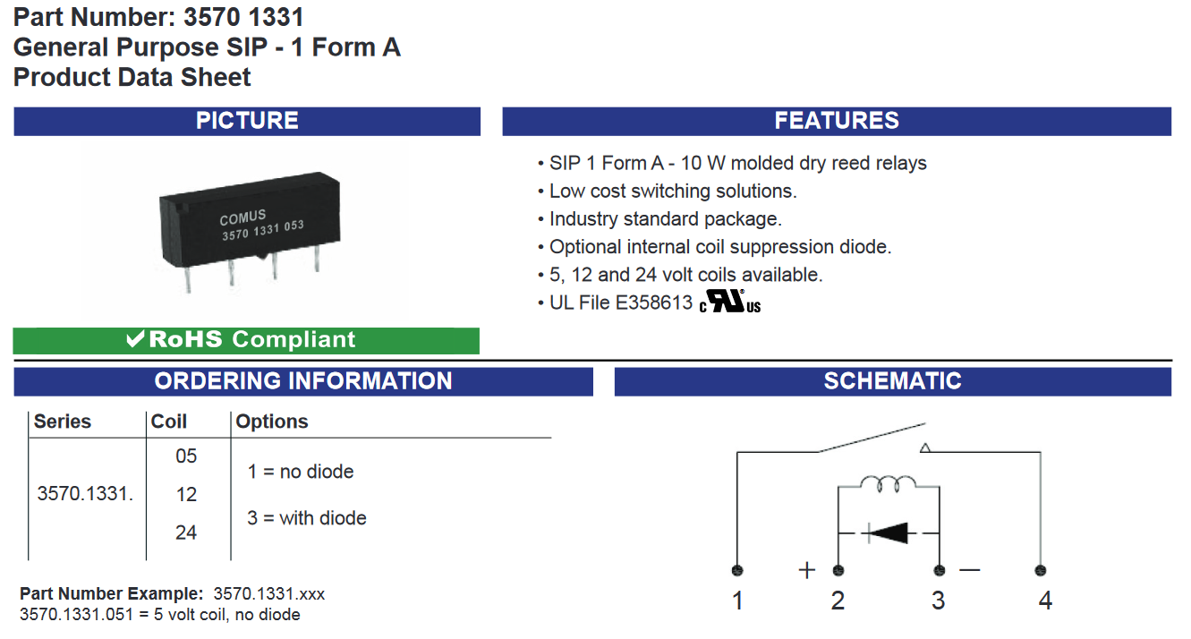
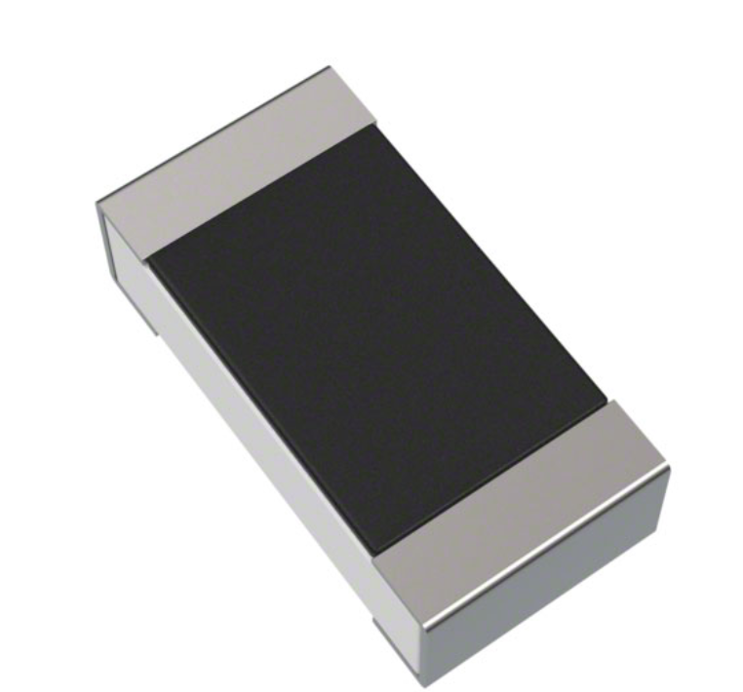
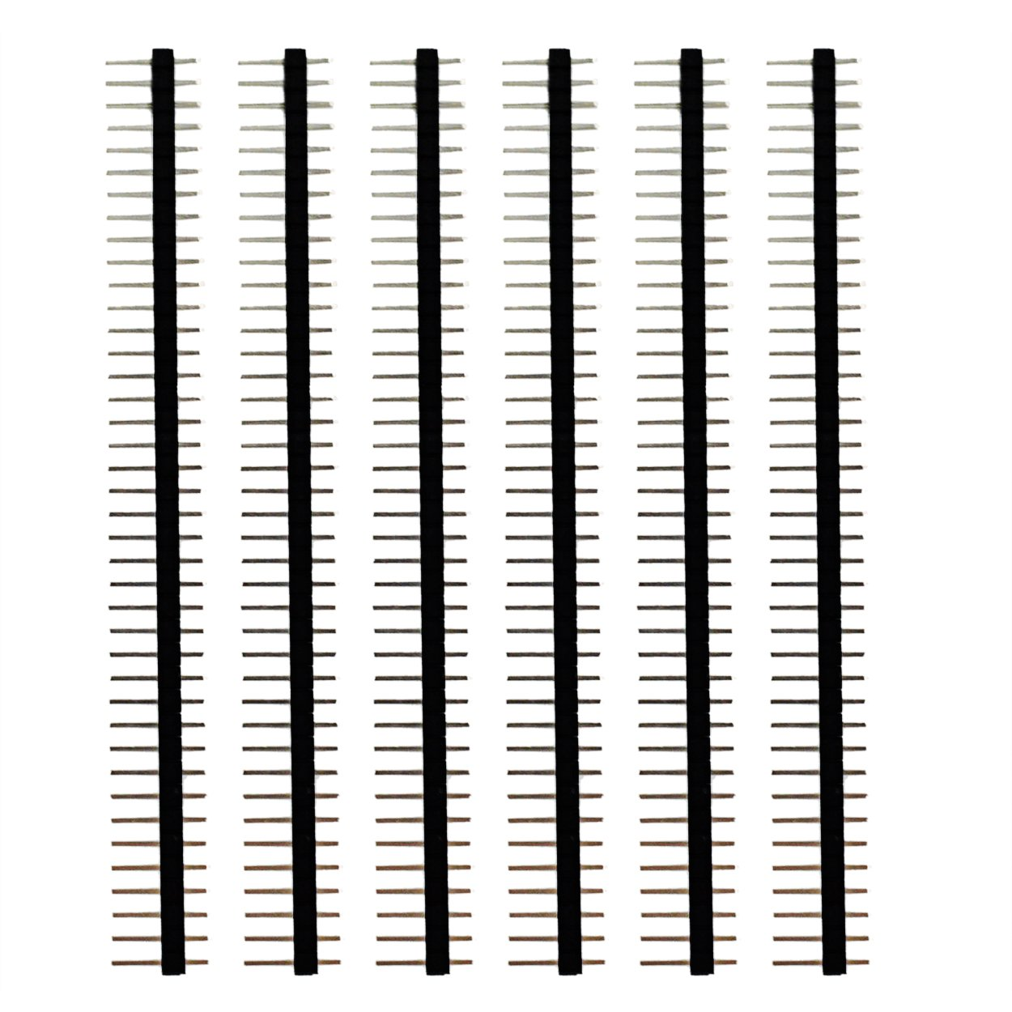
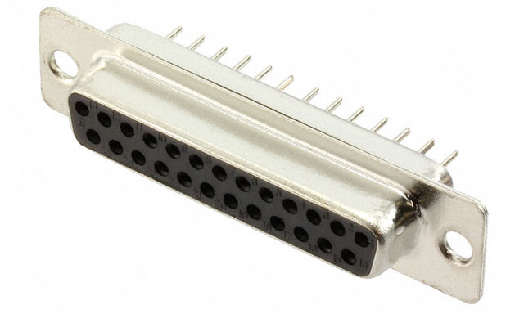
Order Components
5 V relay
1 Mohm resistor 1206 SMT package
https://www.digikey.com/en/products/detail/yageo/RC1206FR-071ML/728388
https://www.digikey.com/en/products/detail/comus-international/3570-1331-053/7497099
0.1” headers, 40 pin strips x1
DB 25 Board Mount Connector
https://www.amazon.com/Header-Lystaii-Pin-Connector-Electronic/dp/B06ZZN8L9S/
https://www.digikey.com/en/products/detail/assmann-wsw-components/A-DF-25-PP-Z/1241794
MEMSDuino

Slide 4
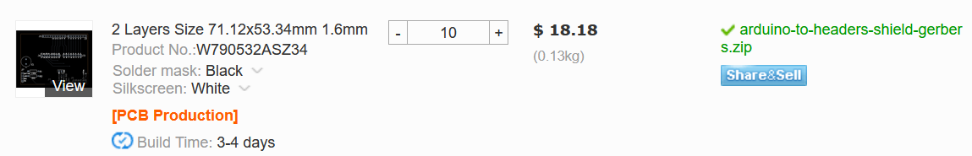
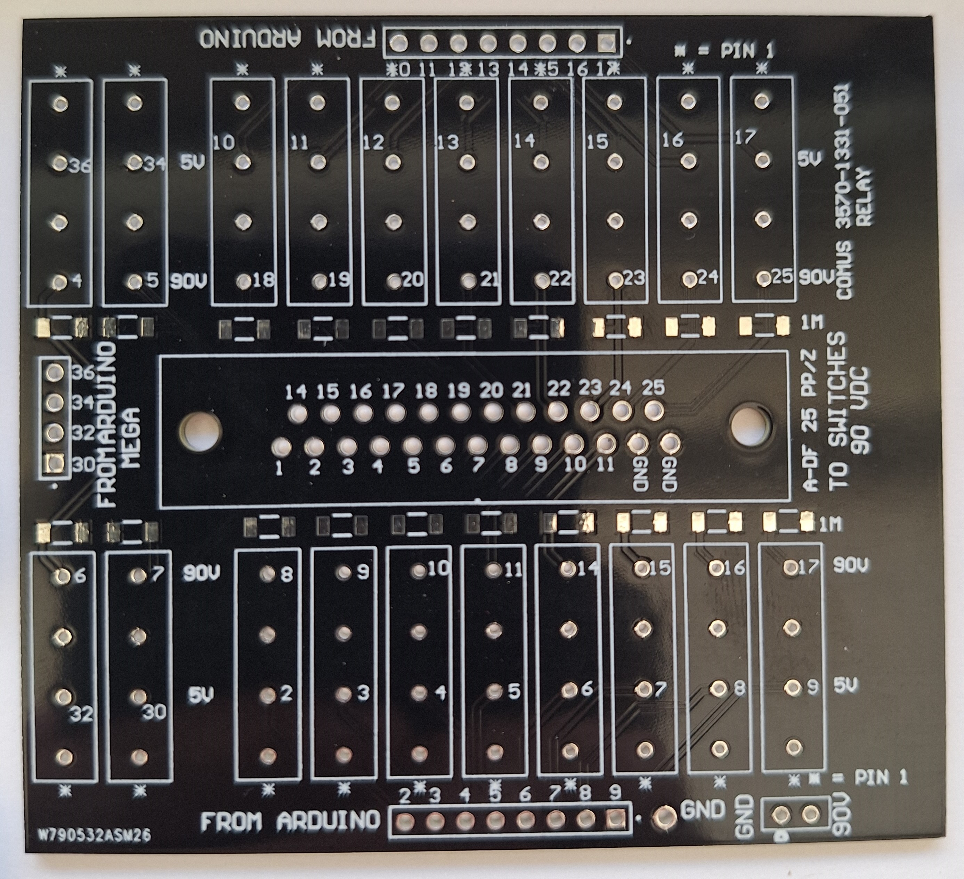
Order Circuit Boards
https://www.pcbway.com
78.74 x 71.12 mm
(3.1 x 2.8 in) size
Black solder mask
White silkscreen
1.6mm FR4
https://github.com/lafefspietz/MEMSduino/raw/main/PCB_files/DB25-relay-HV-control-gerbers.zip
MEMSDuino

Slide 5
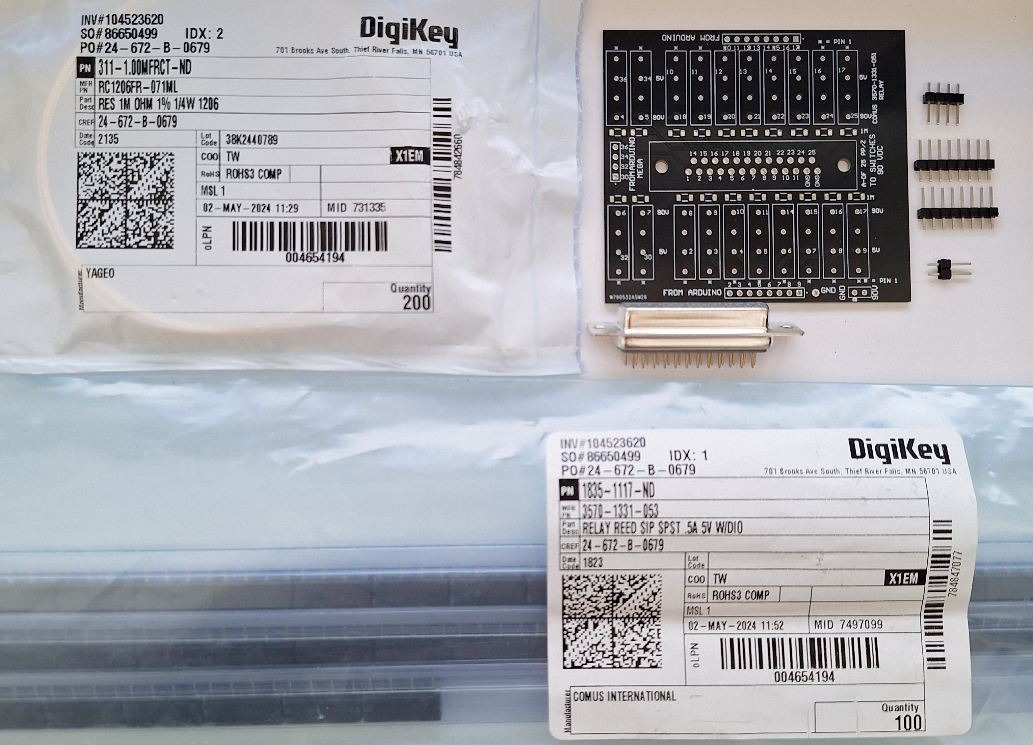
Assemble Kit
MEMSDuino

Slide 6
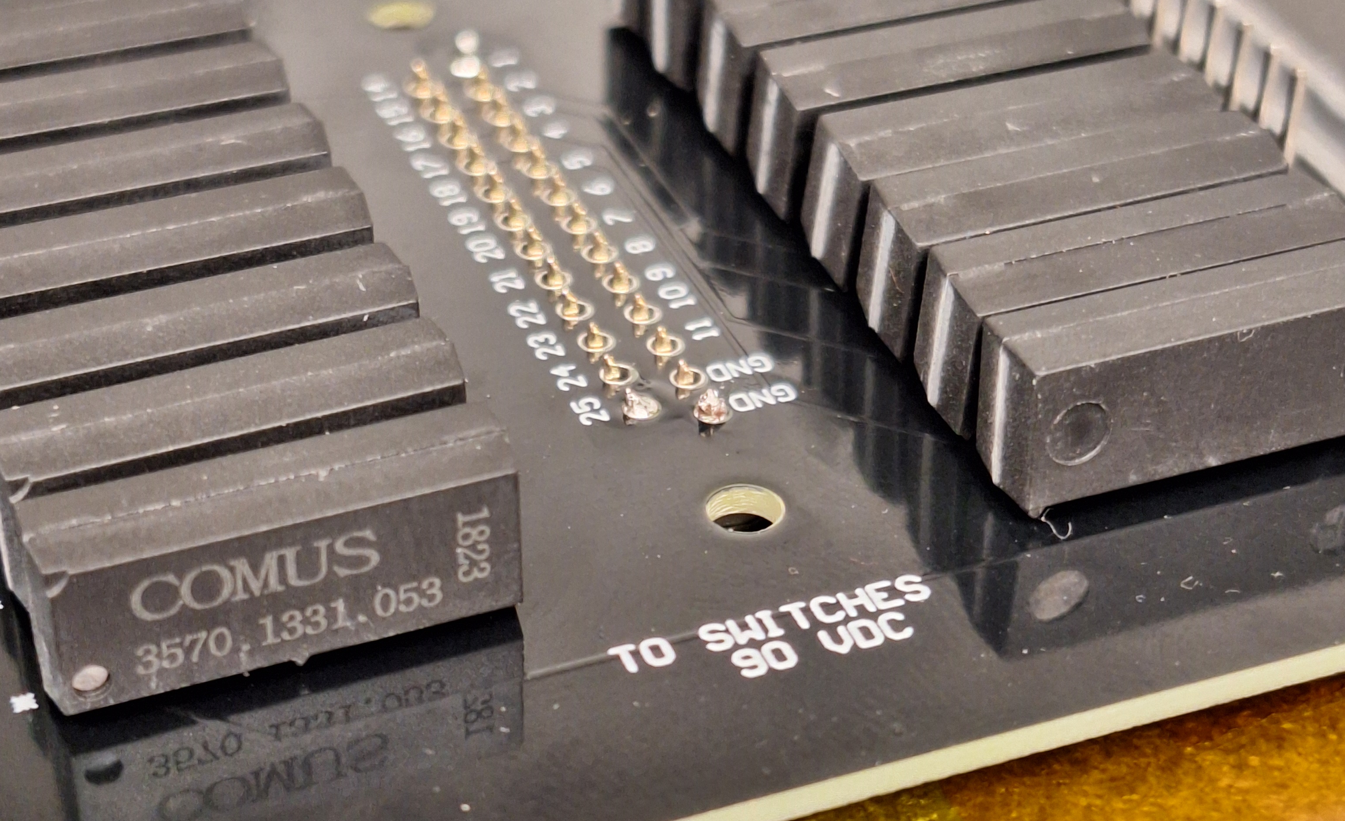
Lift board up when soldering to increase clearance
MEMSDuino

Slide 7
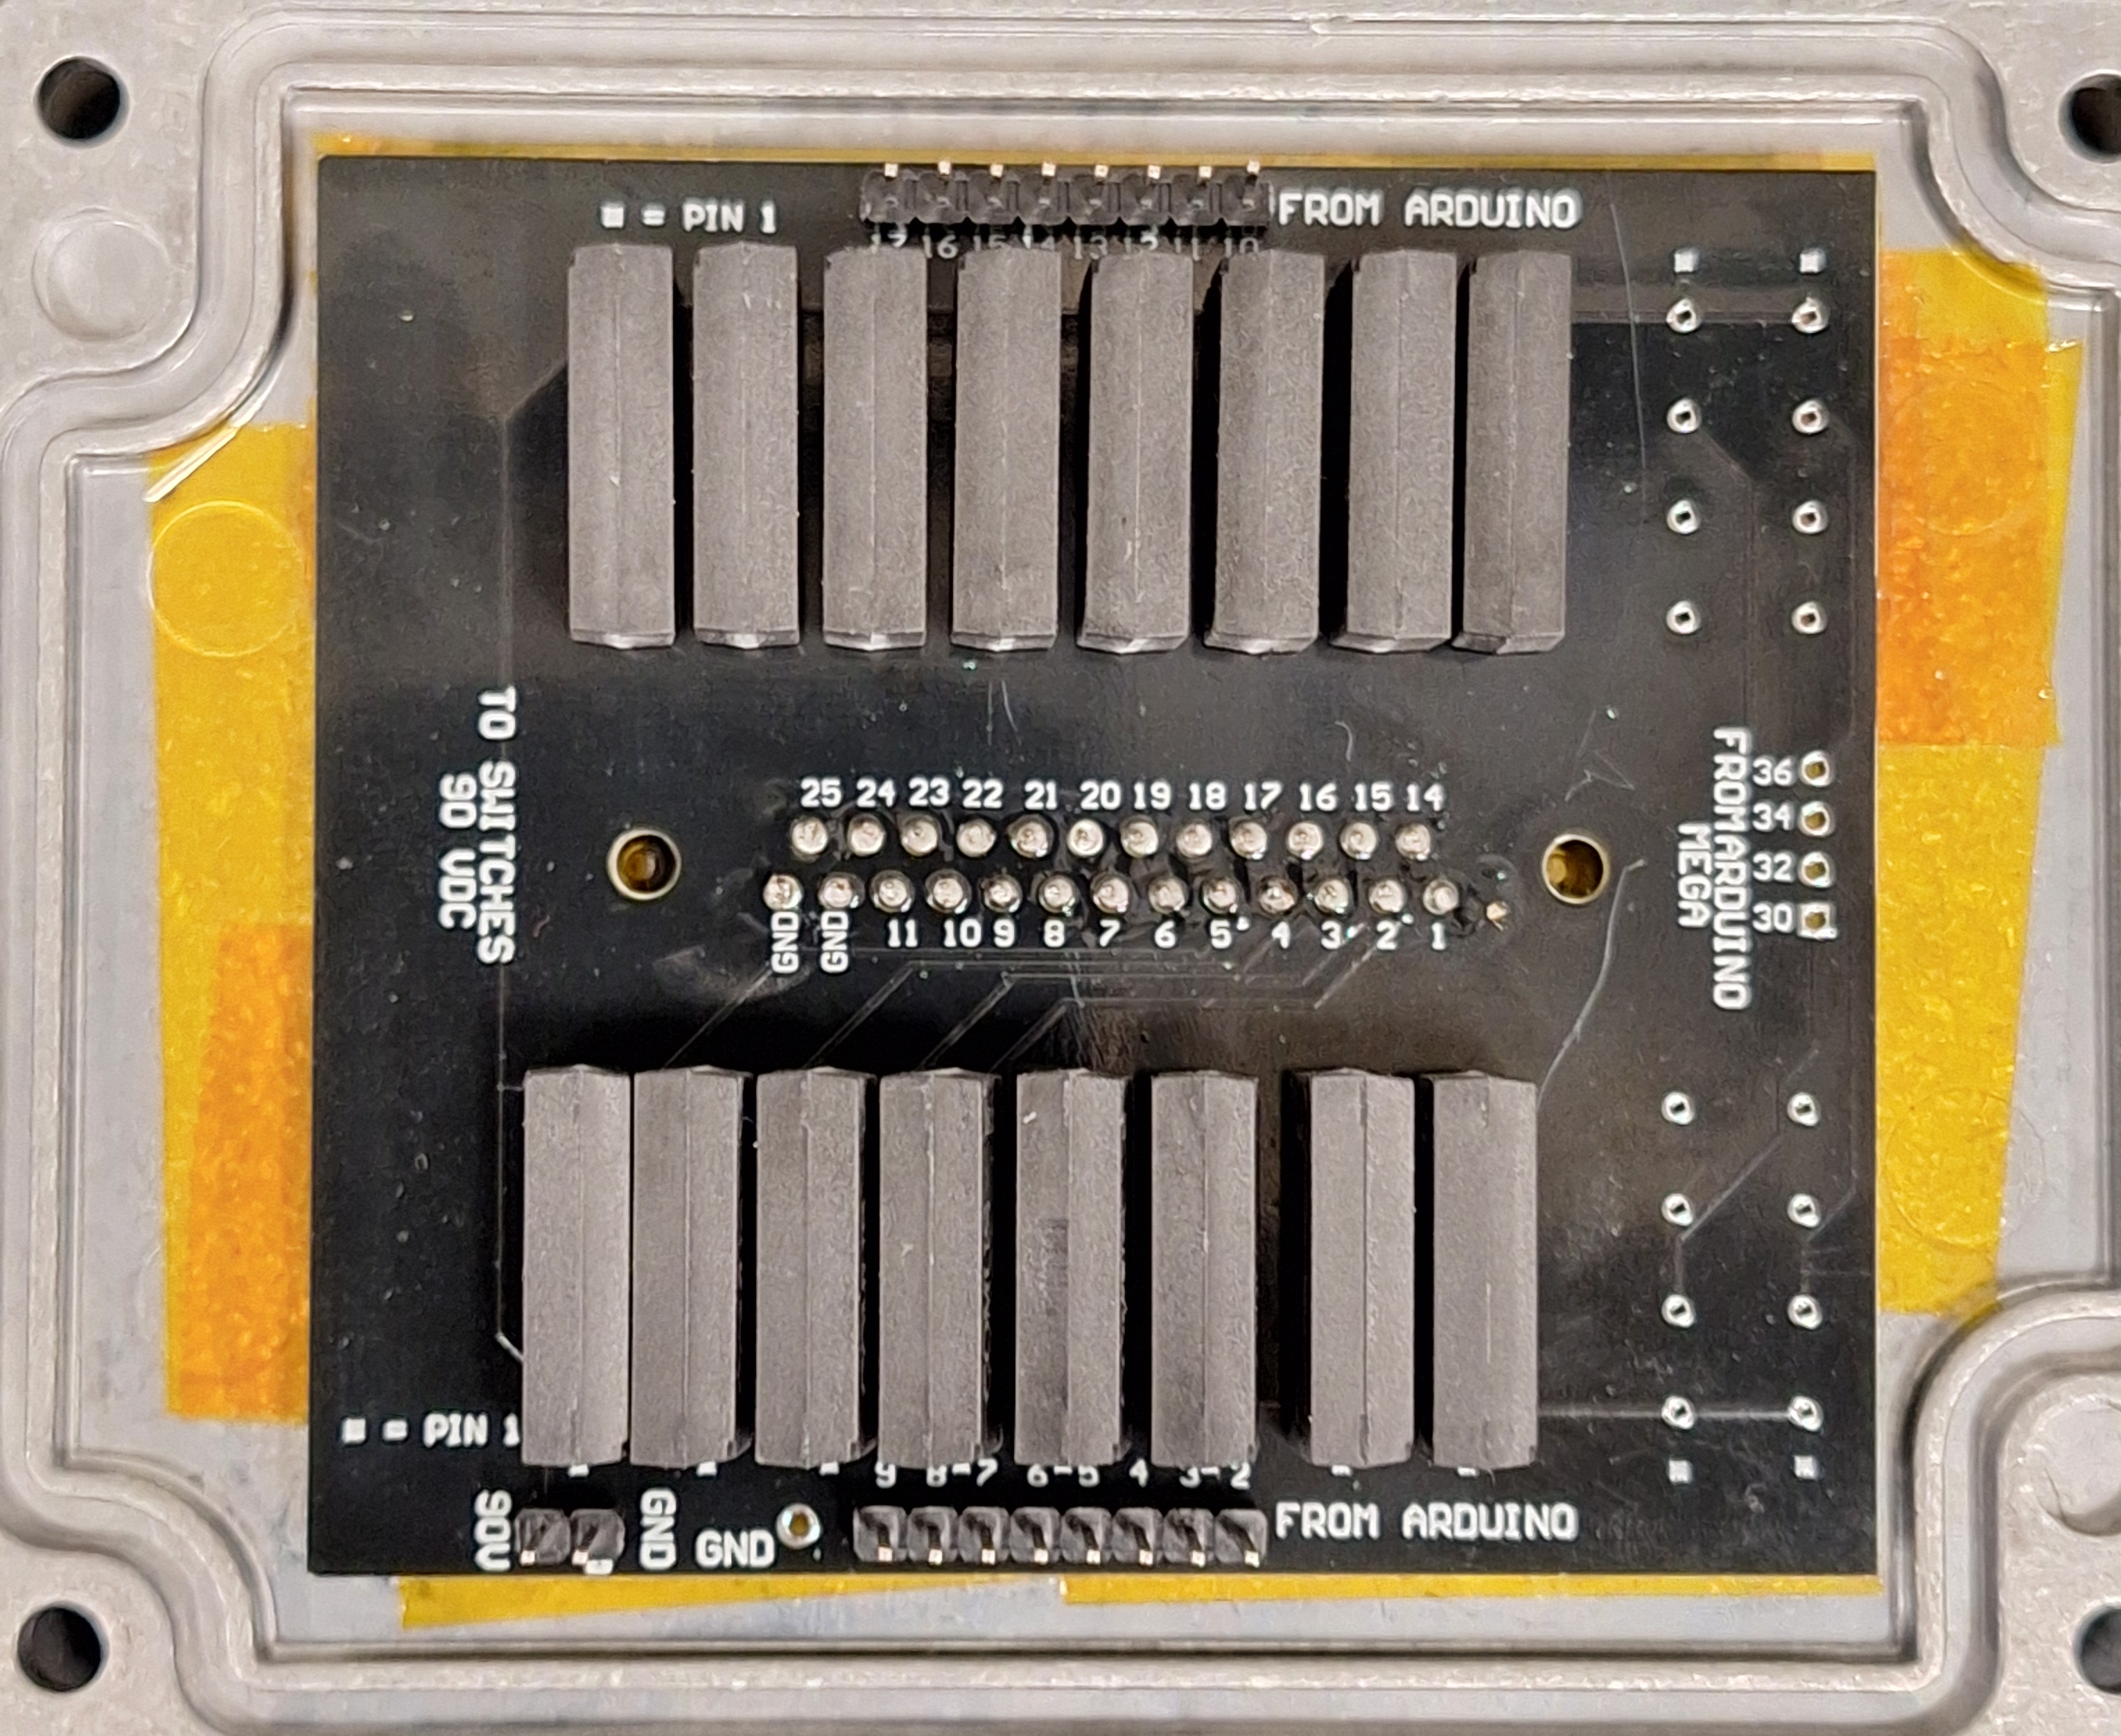
Assembly
MEMSDuino

Slide 8
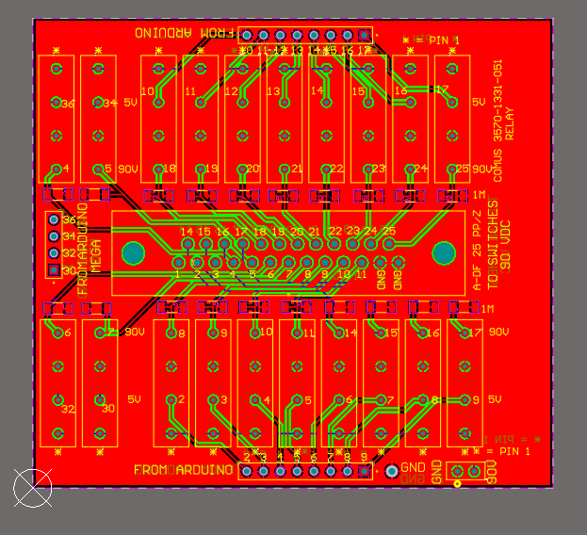
MEMSDuino

Slide 9
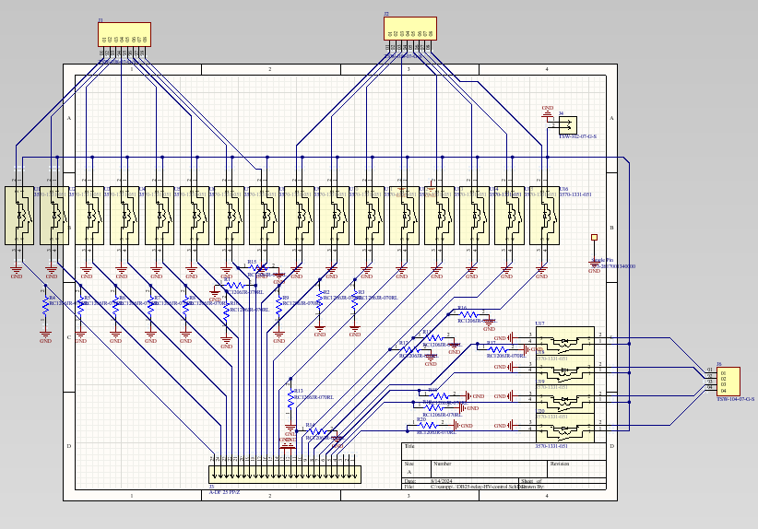
MEMSDuino

Slide 10
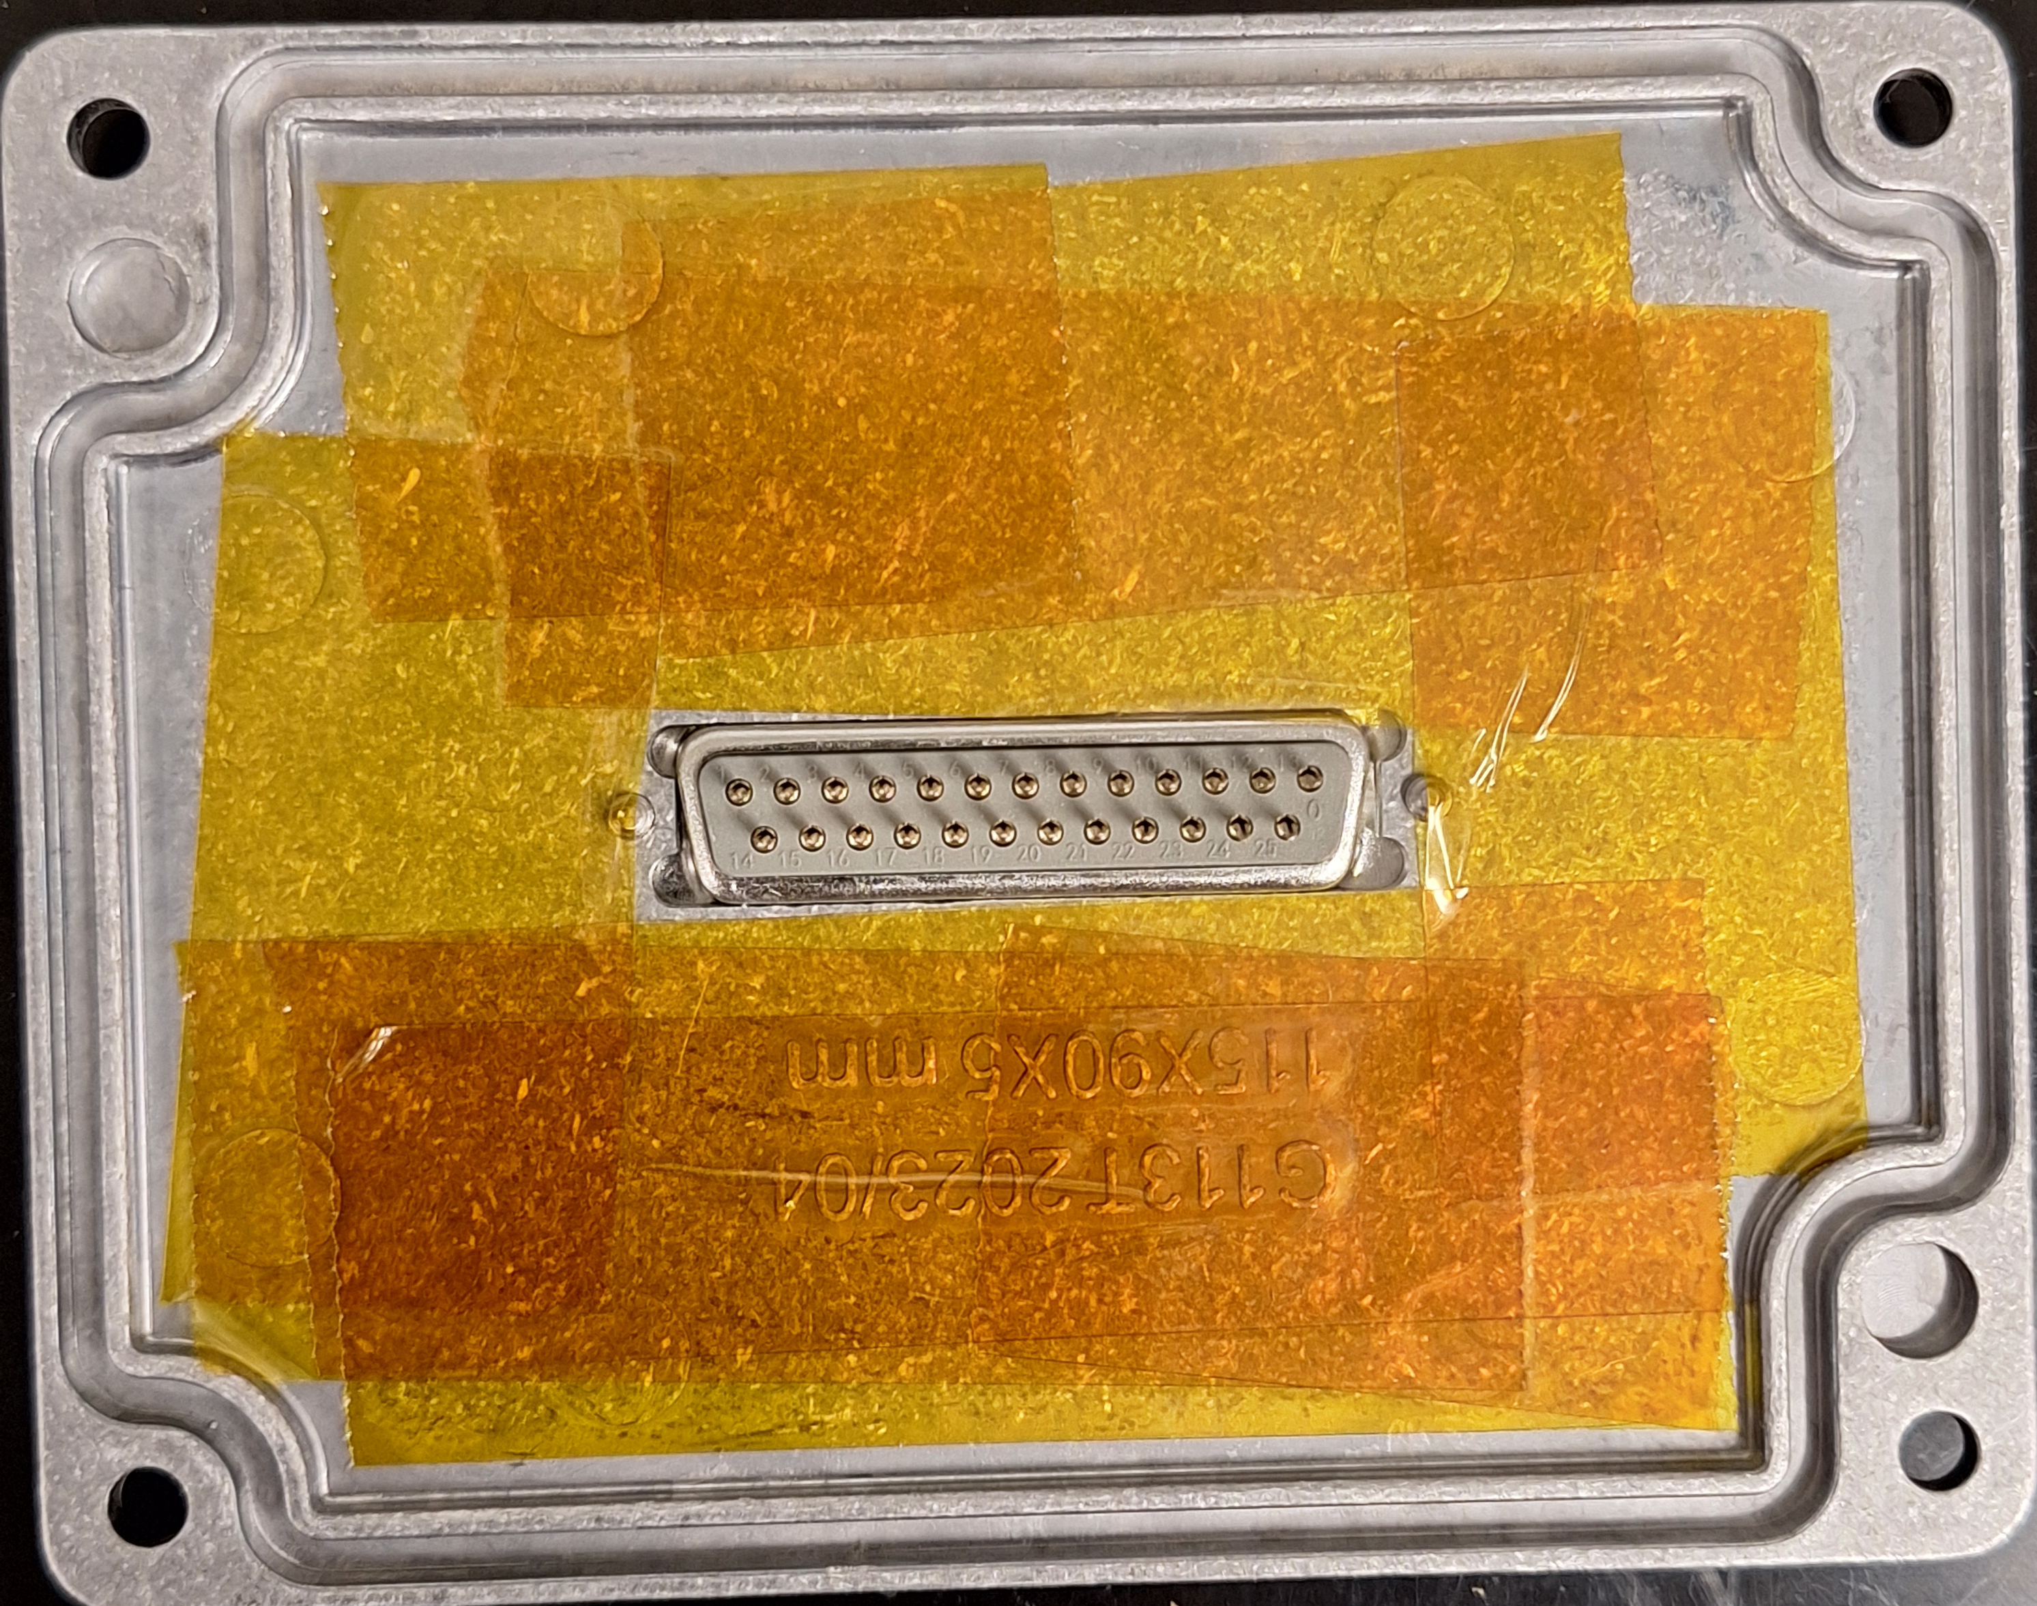
Adding polyimide tape to the lid
This must be assembled before the circuit board is soldered to the DB25 connector!
Prevent potential shorts
MEMSDuino

Slide 11
Relay
https://www.digikey.com/en/products/detail/comus-international/3570-1331-053/7497099
MEMSDuino

Slide 12
Conclusions:
The fact that the DB25 connector causes the whole board to be captive is not ideal. An improvement would be some kind of socket and cable alternative which can be unplugged. There are a number of ways this might be done.
MEMSDuino

